Slide 1
Docker - Manipulate container
Hung.Tran

Slide 2
CONTENT
Docker run in detail
Overriding default commands
List of running containers
Docker lifecycle
Restarting stopped containers
Removing stopped containers
Using Docker Client
What is Docker Container
How’s docker running on your computer

Slide 3
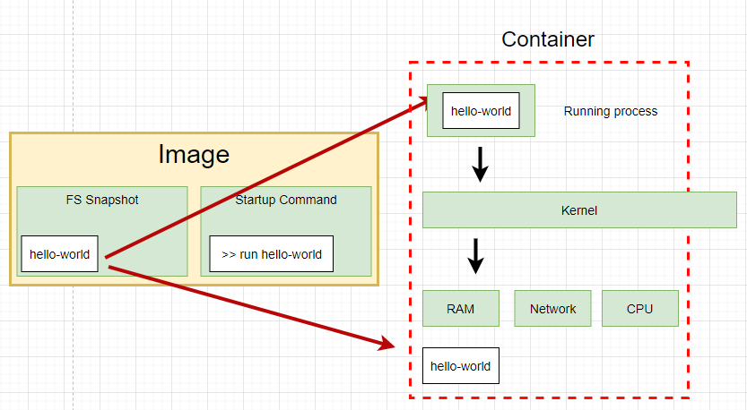
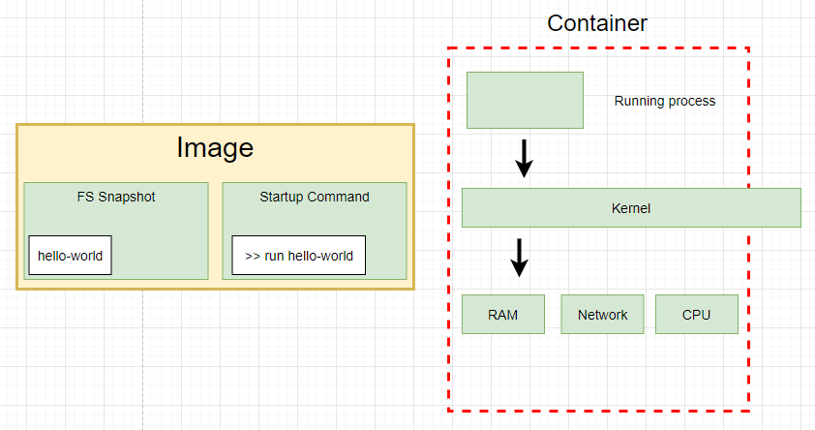
Docker run in detail
docker run hello-world

Slide 4
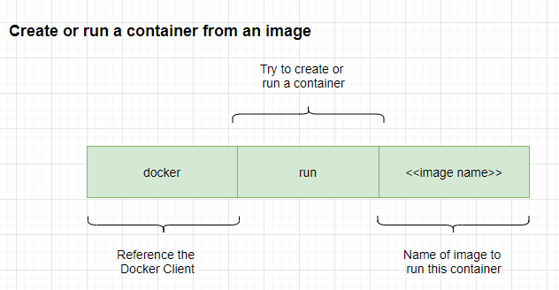
Docker run in detail

Slide 5
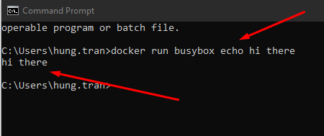
Overriding default commands
Run a command and show message
>> docker run busybox echo hi there
Notes:
we choose busybox becuase it has echo or ls command in its container.
hello-world is a single file container.

Slide 6
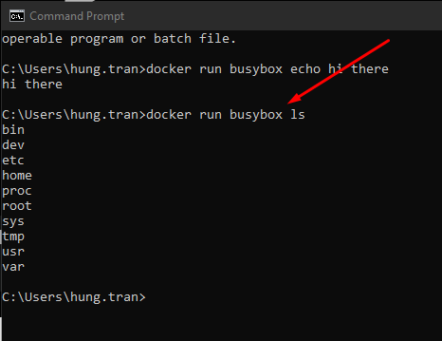
Overriding default commands
Show list of foder of the container
>> docker run busybox ls

Slide 7
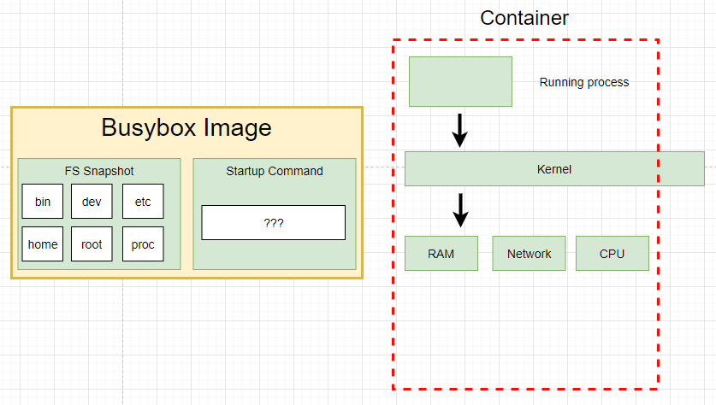
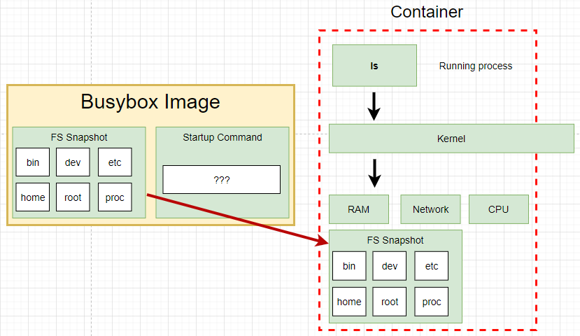
Overriding default commands
Show list of foder of the container
>> docker run busybox ls

Slide 8

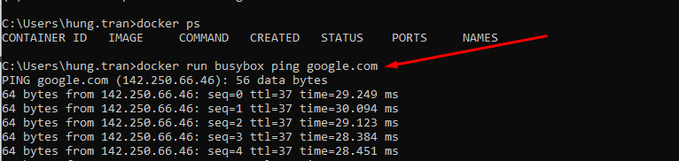
List of running container
Show list of running container
>> docker ps

Slide 9
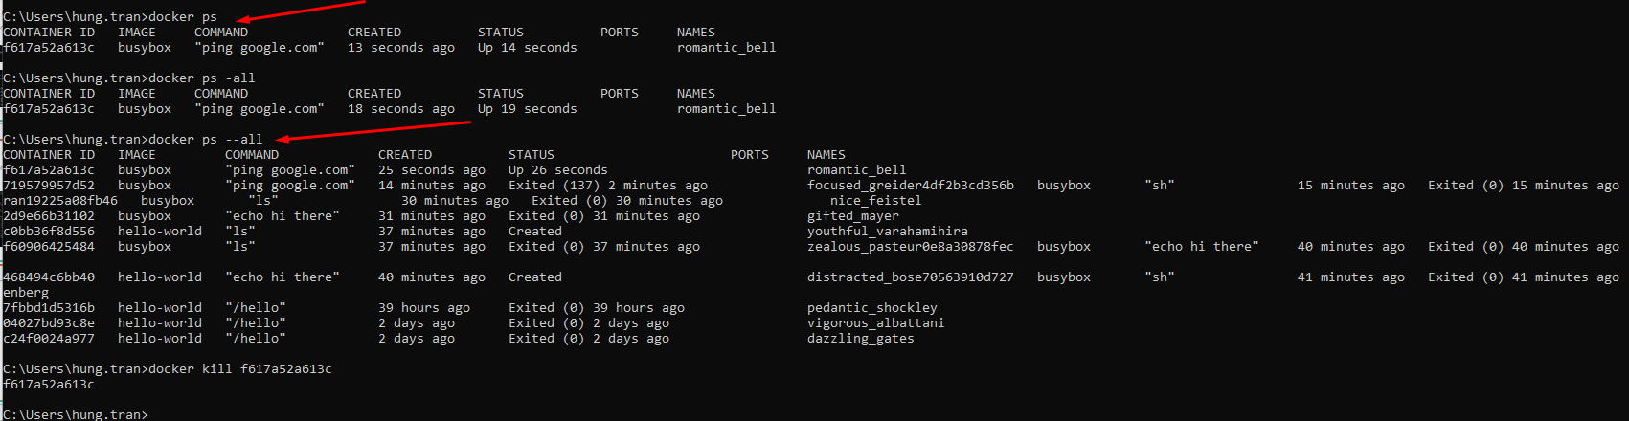
List of running container
Show list of running container
>> docker ps
Show all containers that have ever been created on our machine
>> docker ps --all

Slide 10
Docker lifecycle
docker run hello-world

Slide 11
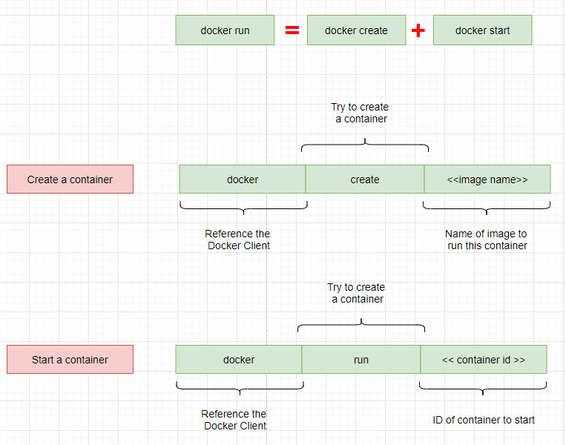
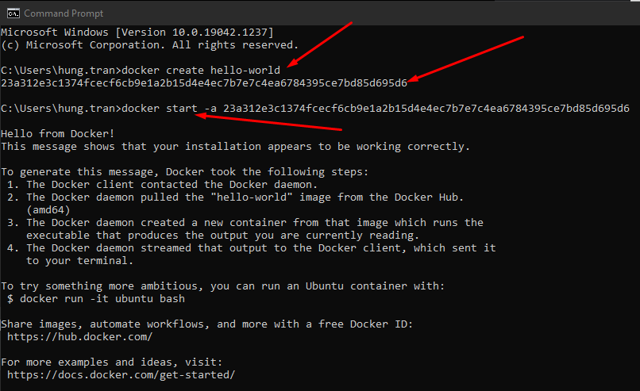
Docker lifecycle
docker run hello-world
Notes:
docker start -a hello-world
-a is a option, let the docker show the output coming from it and print it out at the terminal
docker run
=> is going to show you all the logs or all the information coming out of the container by default

Slide 12
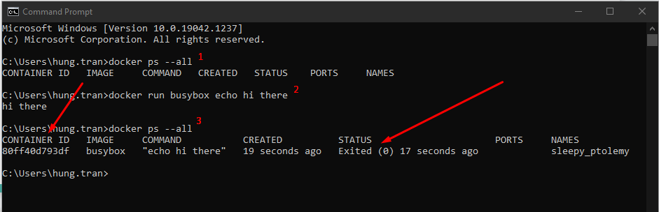
Starting stopped container
Status = exited, mean it’s instance till exist in the cache, so we can recall it by using its ID
Notes:
check all container are running
>> docker ps --all
run busybox container
>> docker run busybox echo hi there
check all containers are running
>> docker ps --all
Restart a stopped container by using its ID
>> docker start -a ID
If you try to change the default command, it still show error
>> docker start -a ID echo hello

Slide 13
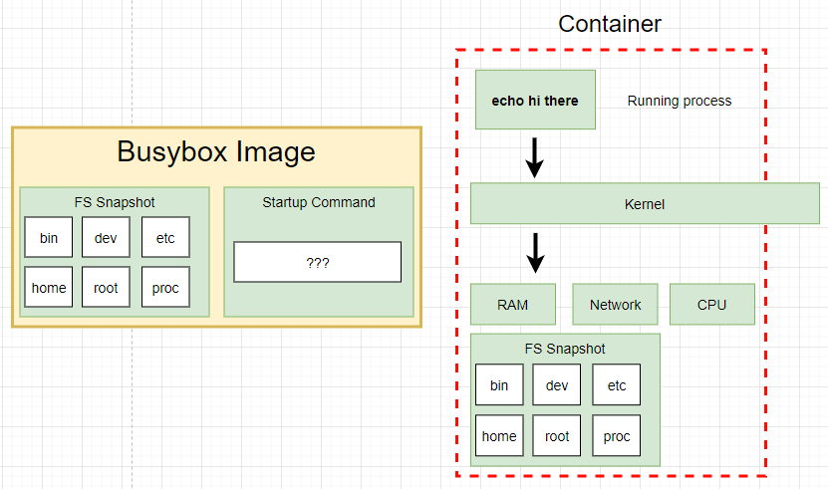
Starting stopped container
Notes:
check all container are running
>> docker ps --all
run busybox container
>> docker run busybox echo hi there
check all containers are running
>> docker ps --all
Restart a stopped container by using its ID
>> docker start -a ID
=> When run the container second time, The primary command will start automatically
If you try to change the default command, it still show error
>> docker start -a ID echo hello
=> It will show the error because the current primary command here cannot override

Slide 14
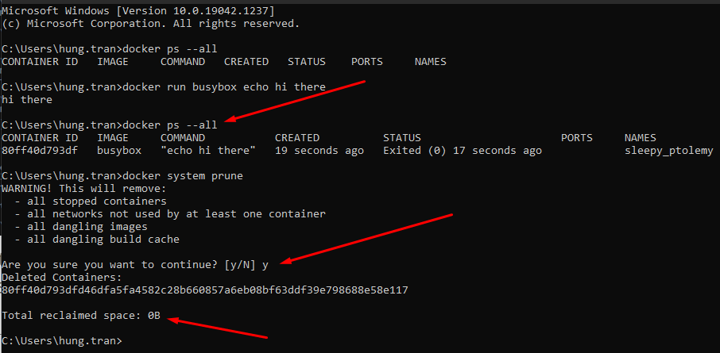
Removing stopped container
docker system prune
=> remove all stopped containers, cache and redownload images from docker hub

Slide 15
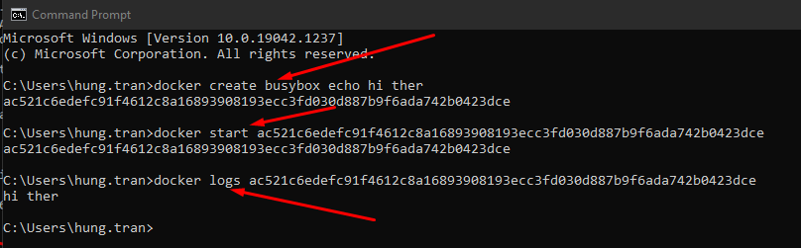
Retrieving log Outputs
docker logs <<container_id>>
=> With this command, we don’t re-run the container again. It only emitted what it works

Slide 16
Retrieving log Outputs
docker logs <<container_id>>
=> With this command, we don’t re-run the container again. It only emitted what it works

Slide 17
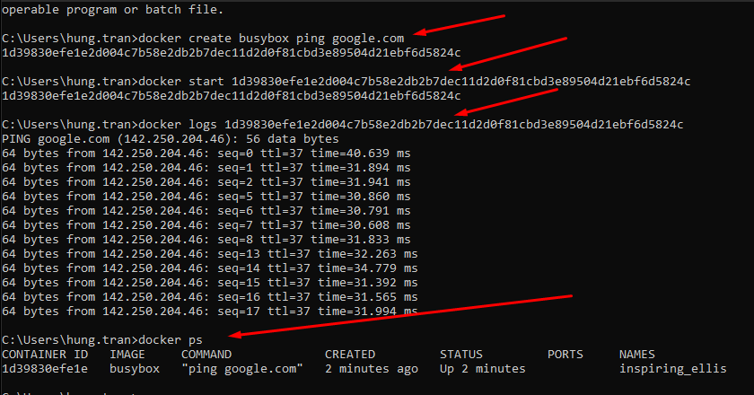
Stopping container
First, create, run and view log of the container

Slide 18
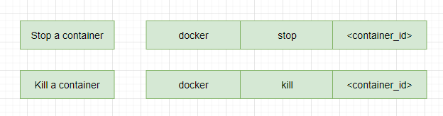
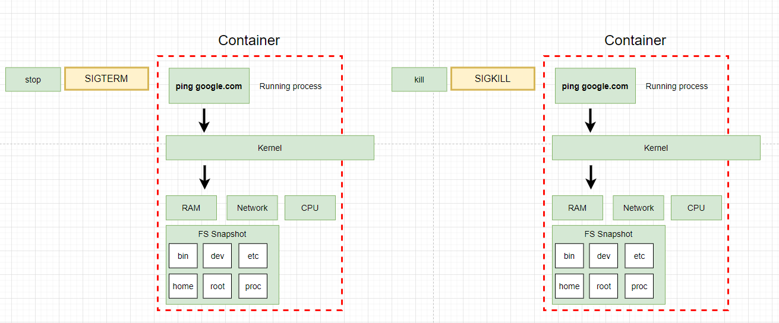
Stopping container
Notes:
stop and kill are used to stop and kill a container. But it has a different
when use stop command, a hardware signal sent to the primary process inside the container (SIGTERM mean terminate signal) to let the container know to shutdown now with a little bit time to clean up the conainer (save files, or emit some messages,...)
- if the container does not stop in 10 seconds, it wil call kill command.
kill command: to sent a signal to the primary container to kill the container immediatelly.

Slide 19
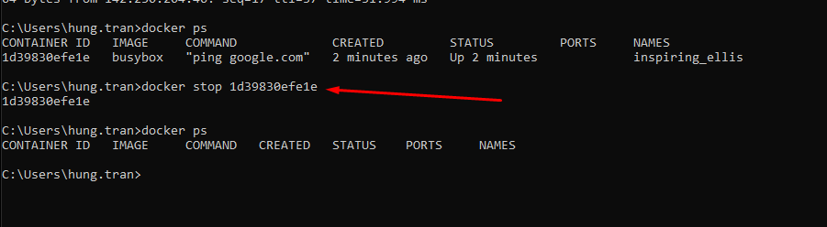
Stopping container
>> docker stop <container_id>
Waiting for over 10 seconds to stop the container

Slide 20
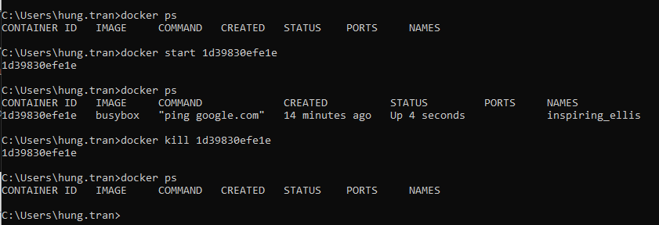
Stopping container
Start container again and use kill command
>> docker kill <container_id>
Stop the container immediately

Slide 21
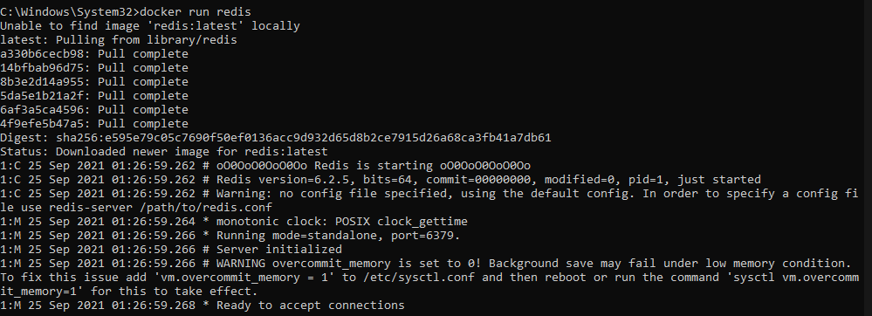
Multi-Command container
First, Settup redis on docker
>> docker run redis

Slide 22
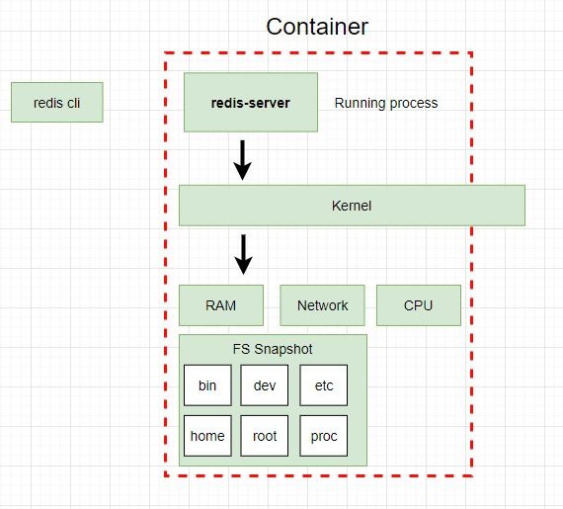
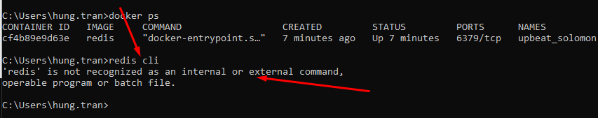
Multi-Command Container
try to run redis-cli but it’s not working because the command run outside the container

Slide 23
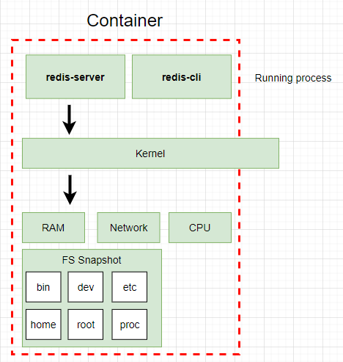
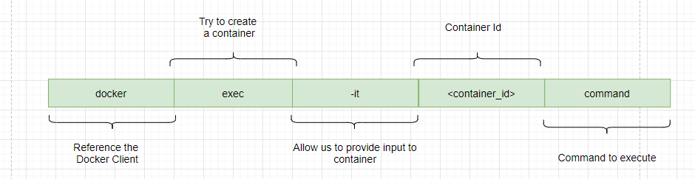
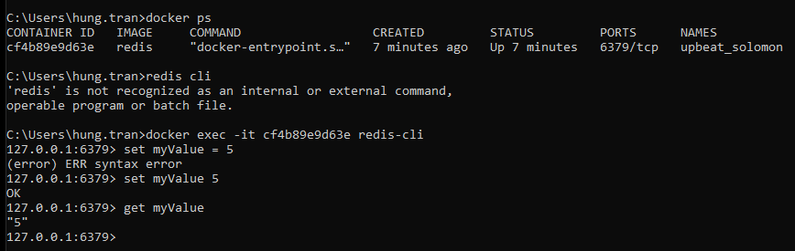
Multi-Command Container

Slide 24
The purpose of the “IT” flag
try to run redis-cli but it’s not working because the command run outside the container
Notes:
When you run a docker in your local machine, every single container that you are running is running inside of a virtual machine running Linux
So these process are really being executed inside of a Linux world, even if you are on Mac or Windows

Slide 25
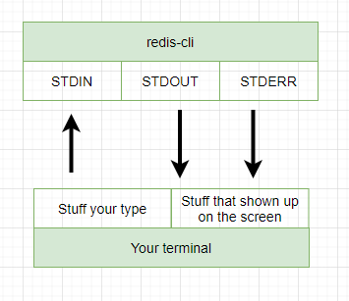
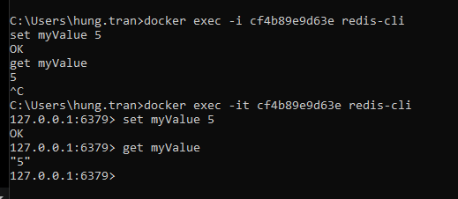
The purpose of the “IT” flag
-i: make sure that any stuff that you type gets direct to STDIN
-t: help to show up the result pretty
Notes:
STDERR: communicate to other outside invironment and return the data and show on the terminal

Slide 26
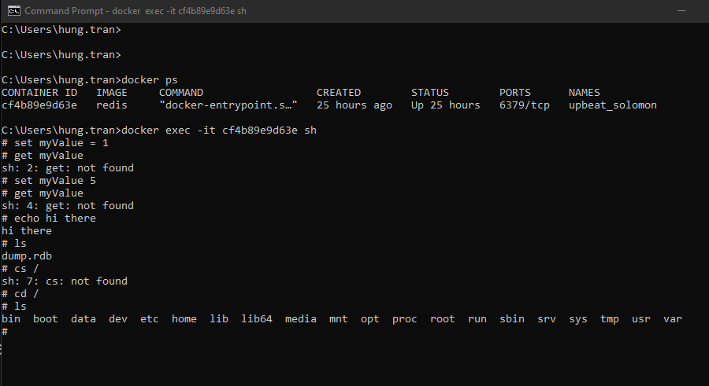
Getting a Command Prompt in a Container
>> docker exec -it <container_id> sh
open a Command Prompt to execute some command

Slide 27
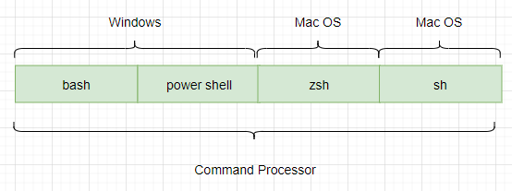
Getting a Command Prompt in a Container
>> sh
Is a name of a program and it’s a program that has been executed inside of that container
Open a Command Prompt to execute some command inside a container

Slide 28
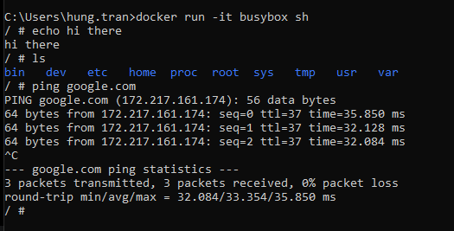
Starting with a Shell
>> docker run <image_name> --it sh
Start a new shell when run new container

Slide 29
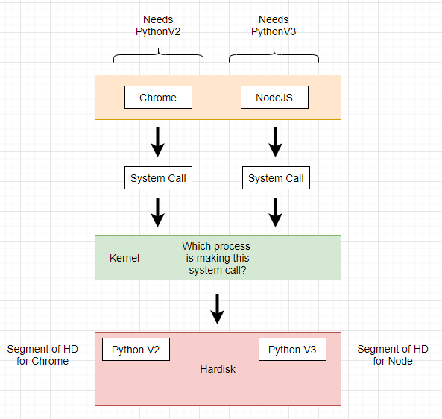
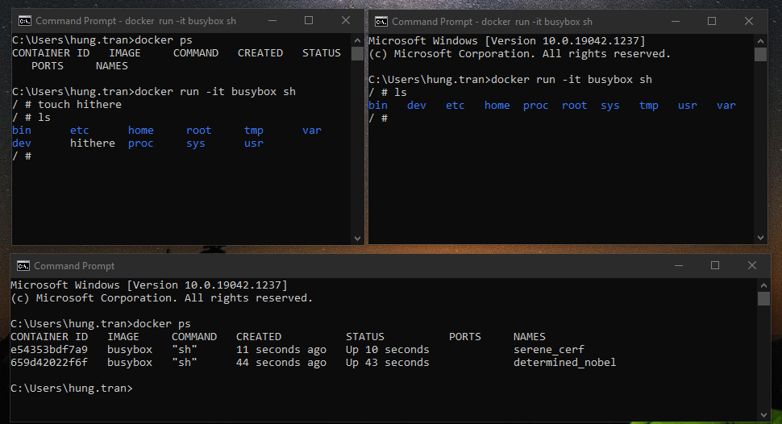
Starting with a Shell
Notes:
run two commands are the same to check its container are shared folder or not

Slide 30
THANKS FOR LISTENING

